Slide 1
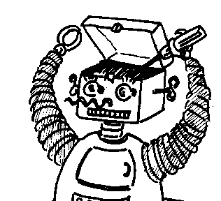
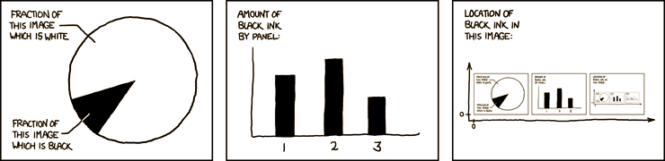

http://xkcd.com/
Maryland Metacognition Seminar
After Phrenology: Toward a Pragmatic, Interactive Account of Brain and Behavior
MICHAEL ANDERSON
Department of Psychology, FRANKLIN & MARSHALL COLLEGE
6 December 2013, 12:00 PM
A.V. Williams Bldg., RM. 3258, College Park
Abstract:
In this talk I will outline some of the evidence that the brain is a non-modular, interaction-dominant, complex dynamic system, the evolved purpose of which is to manage the values of a set of salient organism-environment relationships. These facts point to a need to rethink the nature of the brain and brain-body-environment interactions, as well as the methods we use to study these. I will also suggest we need to re-think thinking. In the view I am advocating, cognition emerges as one special species of the iterative, interactive control processes that form the core of brain function.

